Slide 1
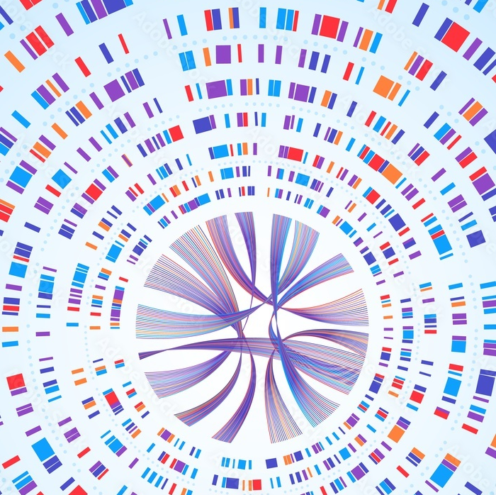







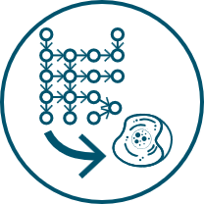

Multiomics data analysis services
Integrate metabolomics into your study
biocrates.com
biocrates data services
Customized
data integration
Detailed report
Data analysis & interpretation
Short turn-around times
For research use only | not for use in diagnostic procedures

Slide 2
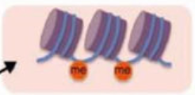
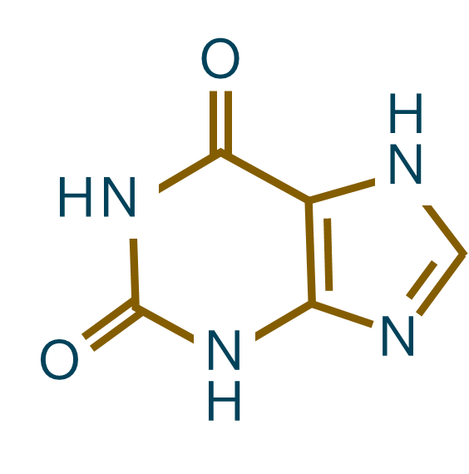
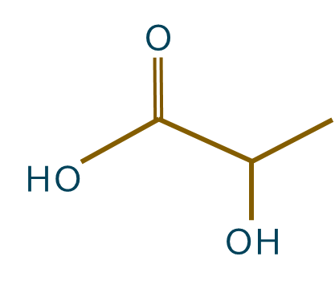



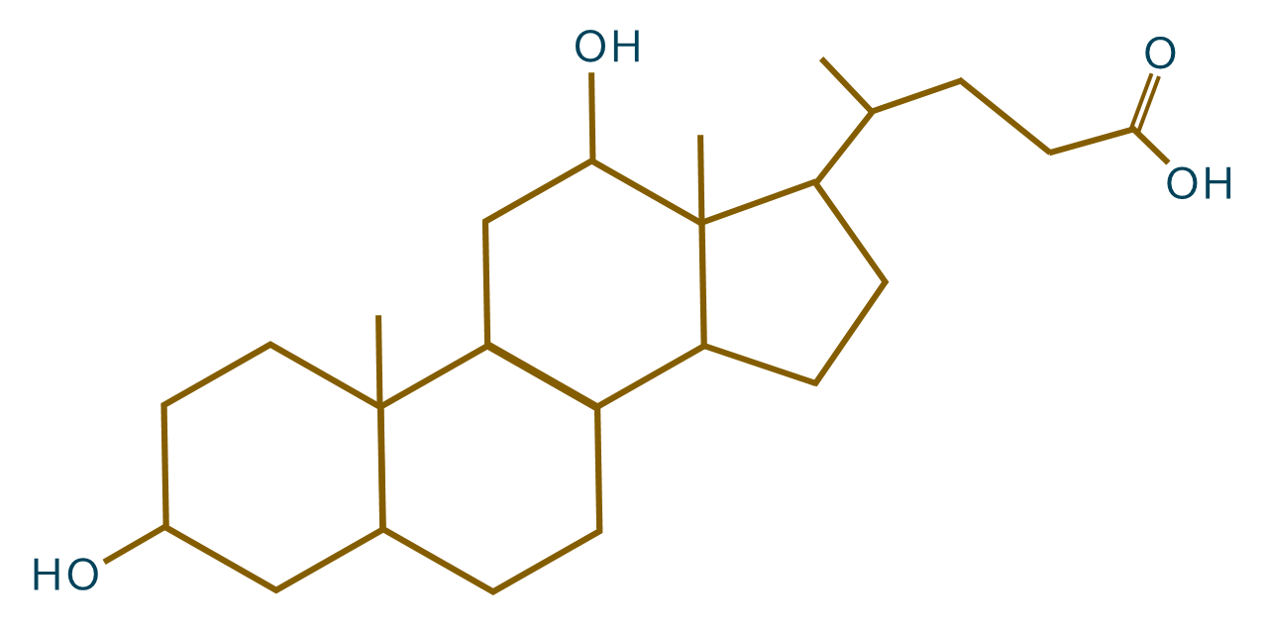




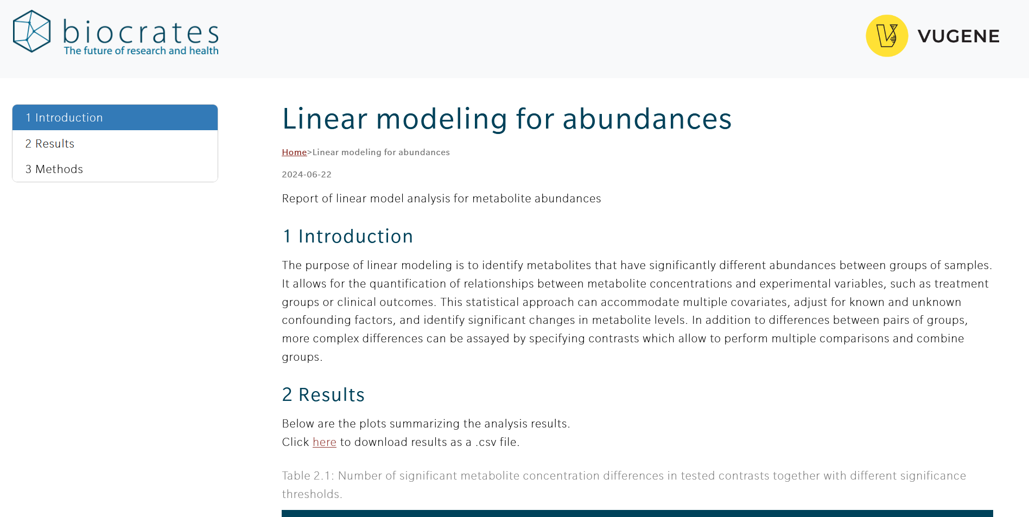
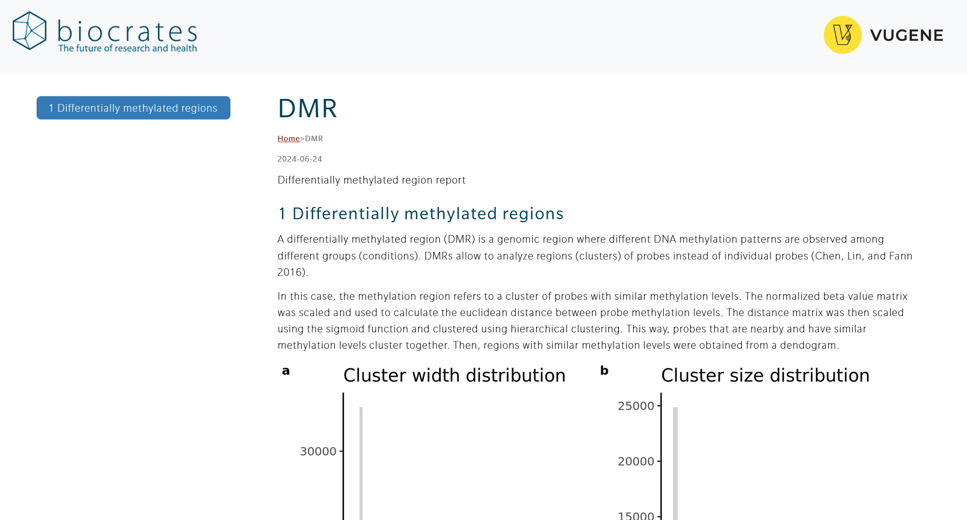
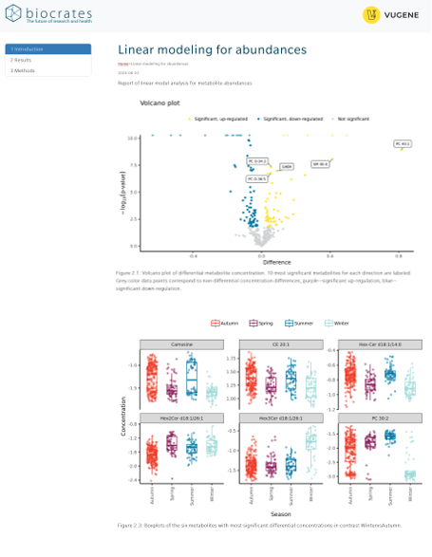
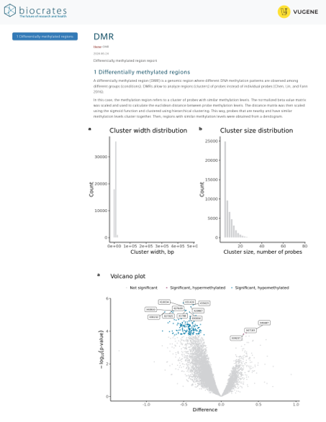
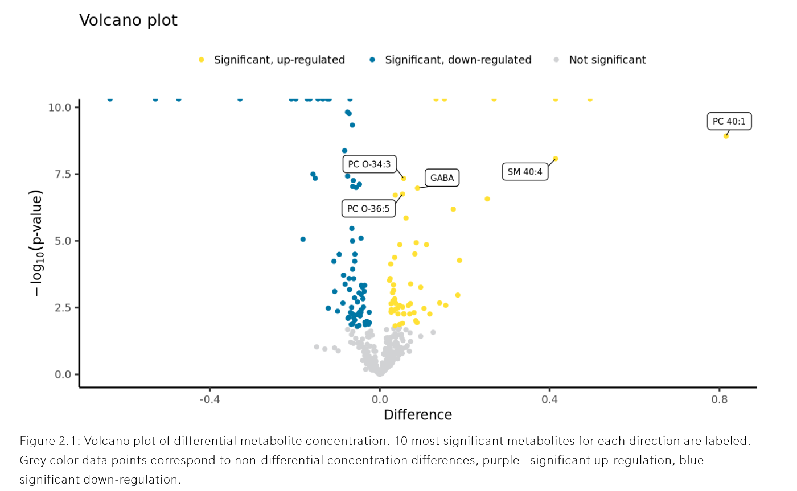
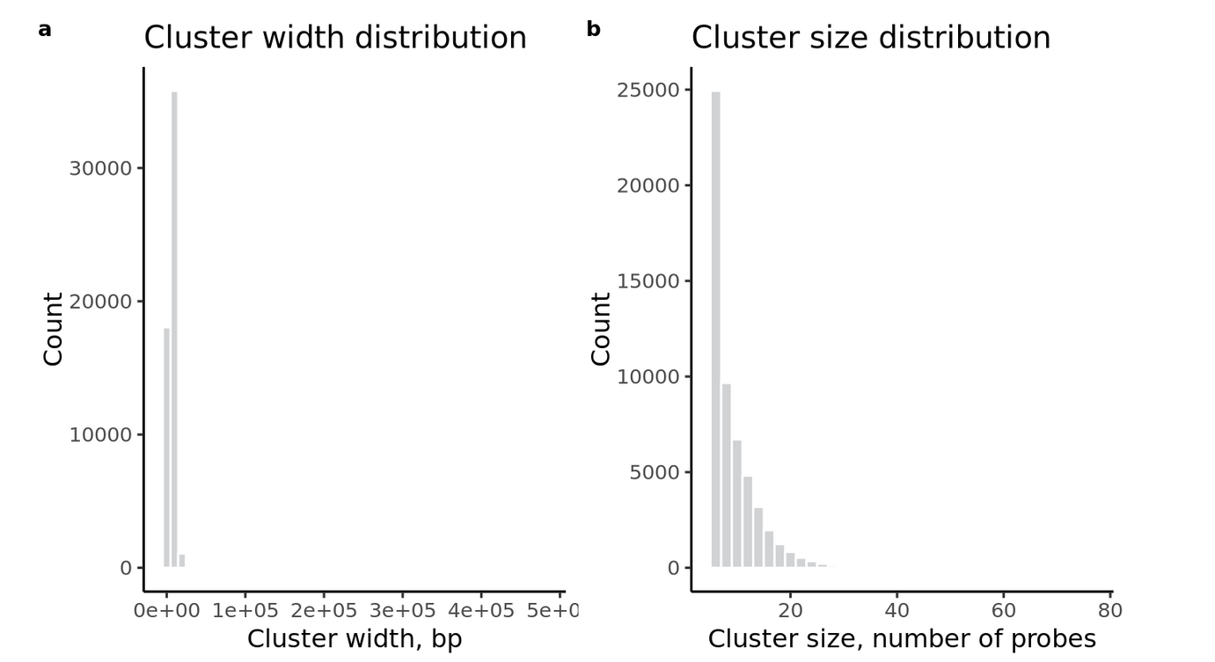
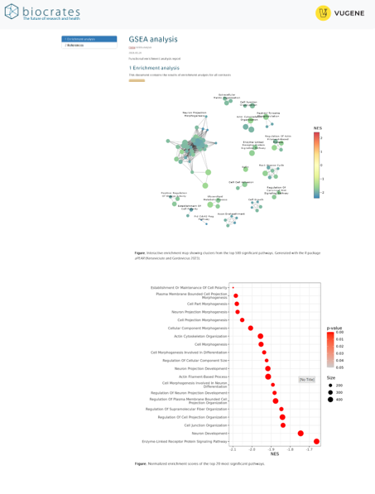
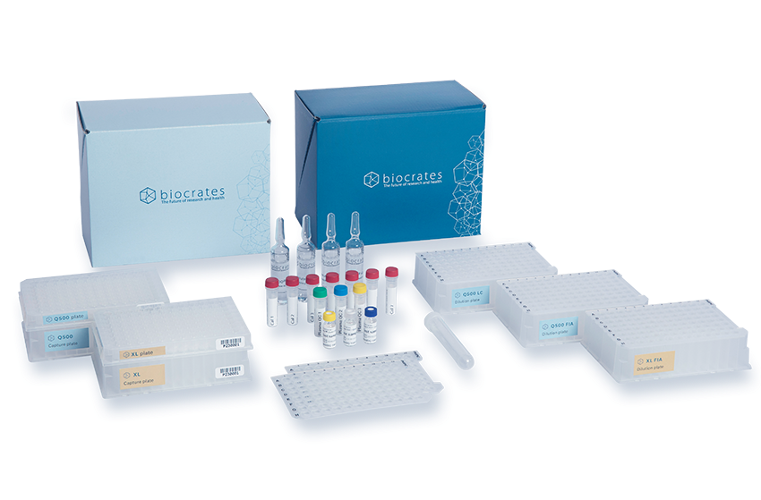
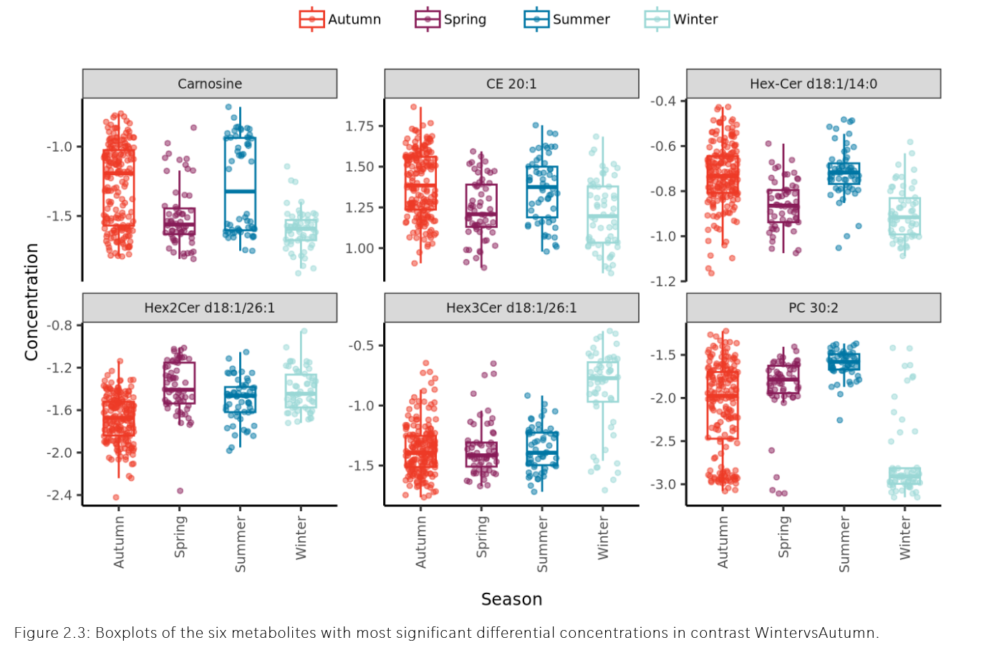
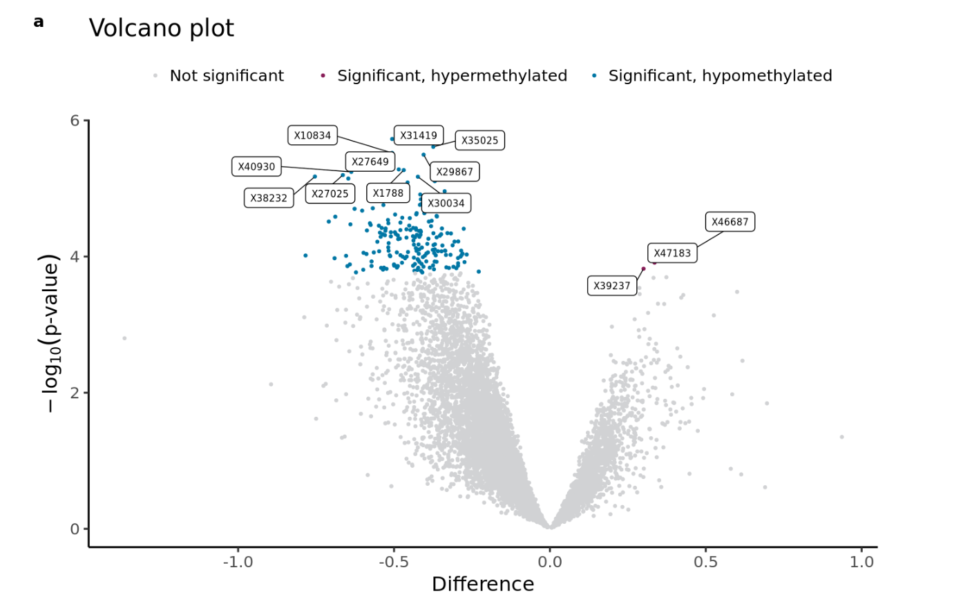

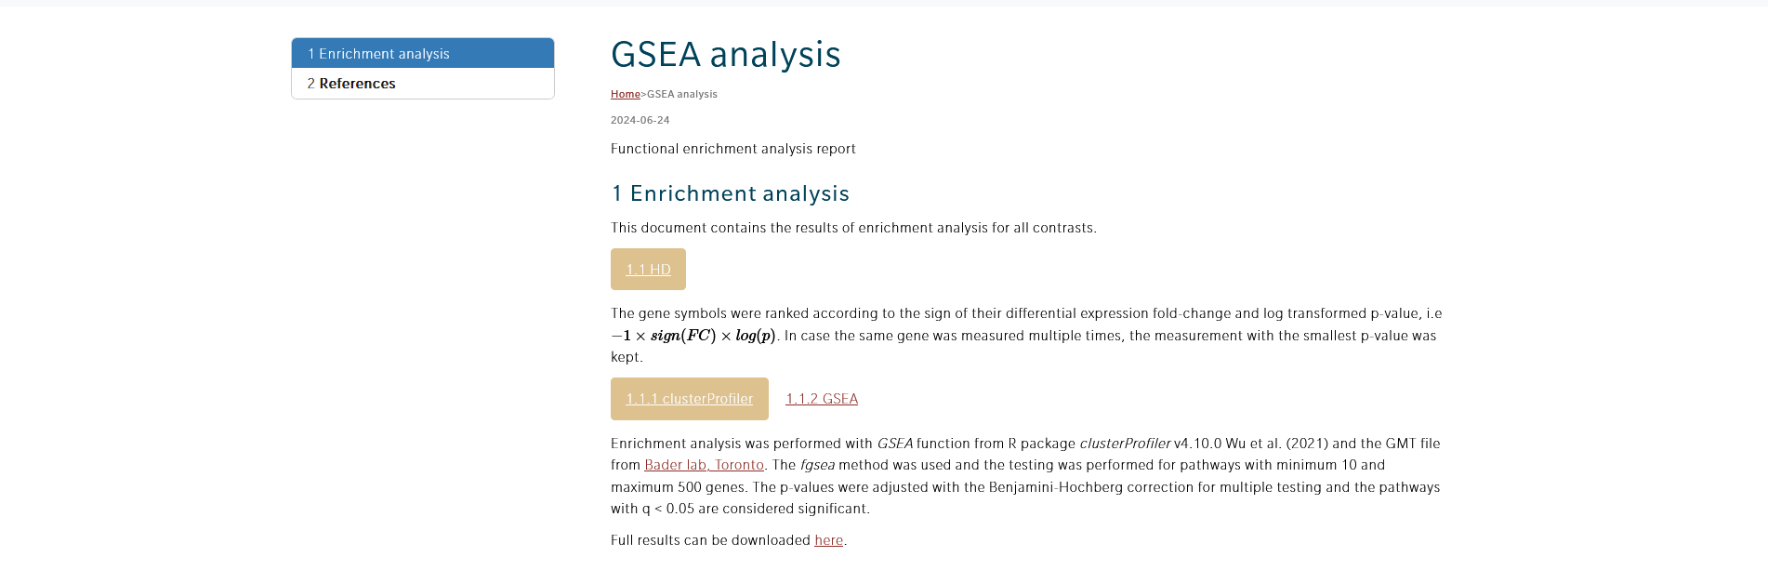
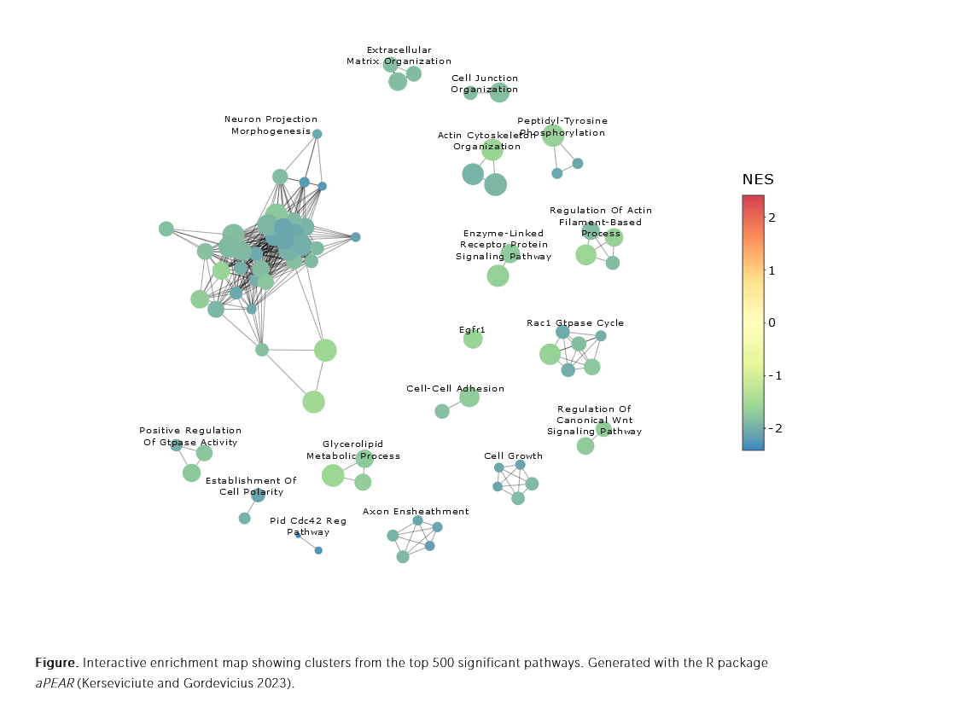

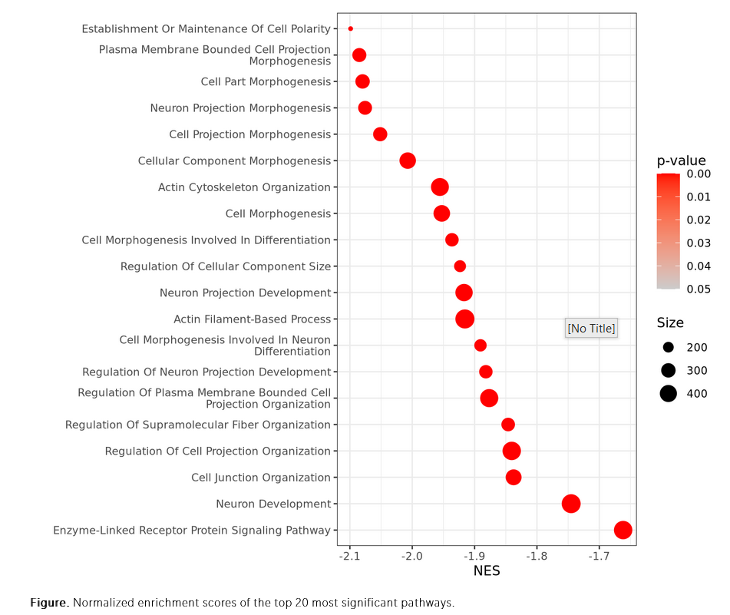
Multiomics data analysis services
We need a new icon for epigenomics
This is DNA rolled around histone proteins with methylations (red)
Metabolites connect omics and bring molecular studies closer to the phenotype
Quantitative metabolomics in context
Metabolites are bioactive and serve as
Signaling molecules
Regulators of gene expression
Epigenetic modifications
Building blocks of macromolecules
Substrates and products of enzymatic reactions
Energy-rich molecules… and much more
For over 20 years, biocrates combines the metabolites most relevant to health into standardized metabolomics kits for seamless integration with other omics
MxP® Quant 500 XL
MxP ® Quant 500
AbsoluteIDQ® p180
AbsoluteIDQ ® Bile Acids
AbsoluteIDQ ® p400
MxP ® Quant HR Xpress
biocrates targeted assays
Cells combine molecules | We combine omics
Combine your metabolomics results with other omics layers to unlock the true potential o molecular approaches
Genes
Whole genome sequencing
Whole exome sequencing
Nanopore sequencing
RNAs
Single cell RNA-sequencing
Bulk RNA-sequencing
Epigenetic modifications
Whole genome bisulfite sequencing
DNA methylation arrays
ATAC-sequencing
Proteins
ChIP-sequencing genome-wide
DNA-protein interaction
Powered by
Your omics platform is not listed here? Contact us for a personalized quote | https://biocrates.com/contact
QR codes are fillers
Please replace with real ones before finalization
Read more
Multiomics data analysis |
Service page
Impact lives with standardized metabolomics
Learn more on how to integrate your omics data
Get more information on how to produce reproducible metabolomics data
https://biocrates.com/multiomics
https://biocrates.com/our-technology/
Address IBK
EU | APAC | RoW phone
NA phone
office@biocrates.com
Last revised 07/2024

